Slide 1
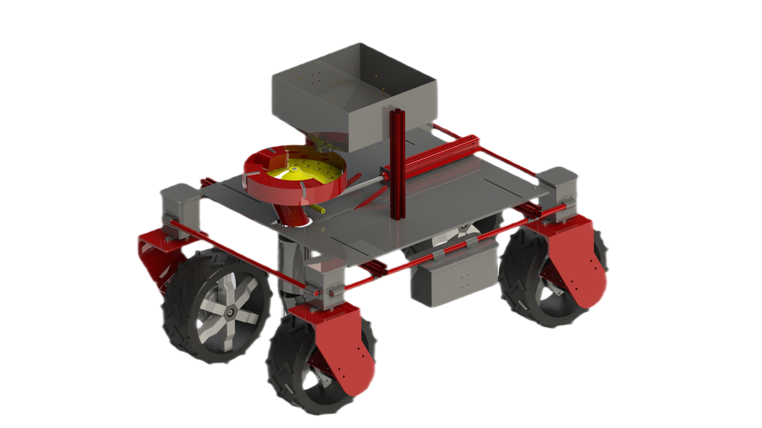
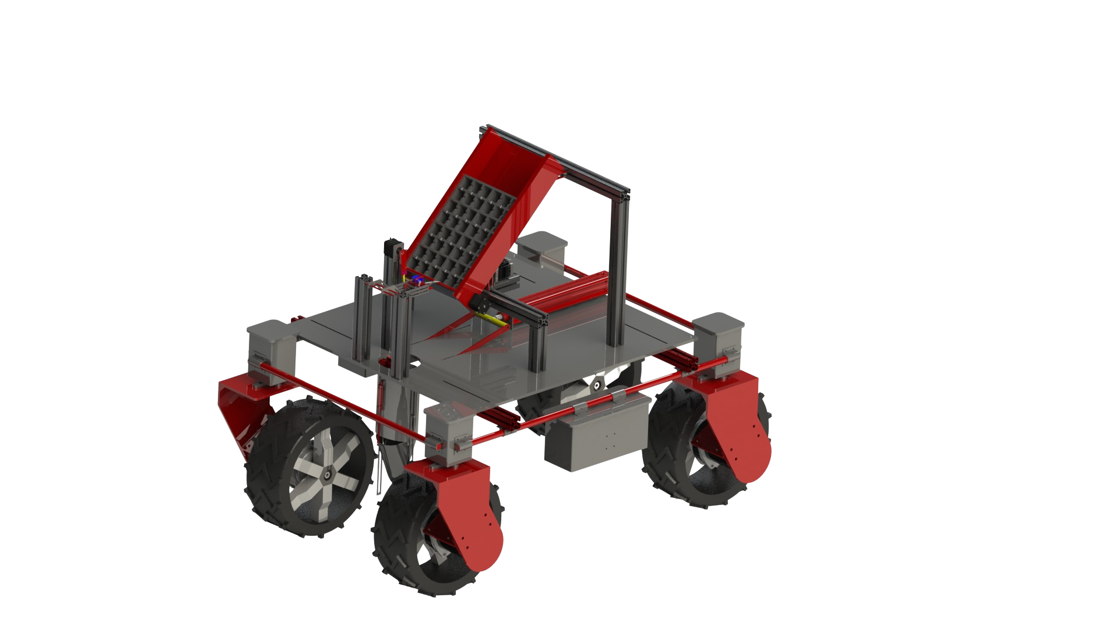
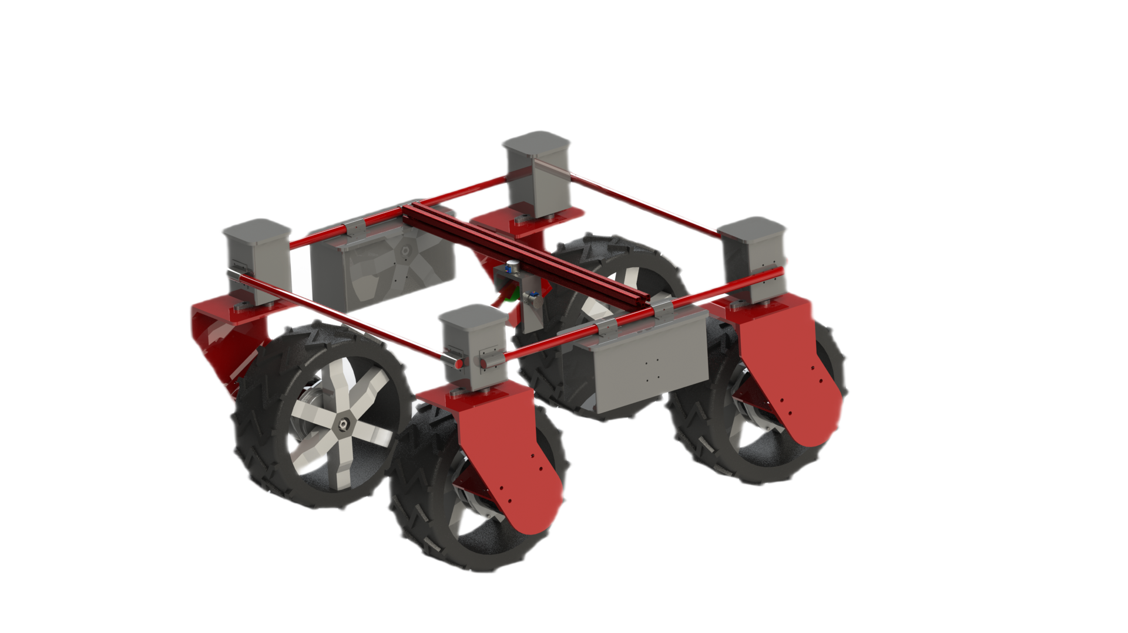
Agro Bot
Design Innovation Challenge
RuTAG-NE’s
Team M4_RTA_9

Slide 2
Problems
Faced
Labour shortage
Small land
holdings
Socio-Economic
Constraints
Poor productivity
Lack of entrepreneurship
02

Slide 3
Vision moderated mechanised system to efficiently use weedicides
One solution
Agro bot
Transplantation
Mechanised system for accurate and continuous transplantation
Weed Removal
Maneuverability
Seed Metering
Suitable design, structure, and weight distribution for working in hilly terrains
Mechanised seed metering device for precise and robust seed plantation , for all seed sizes
03

Slide 4
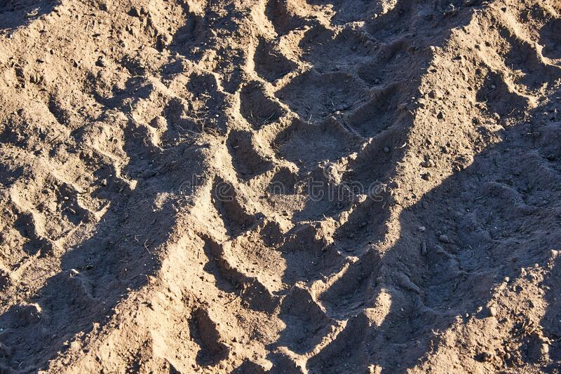
01
Slippage Prevention

Slide 5
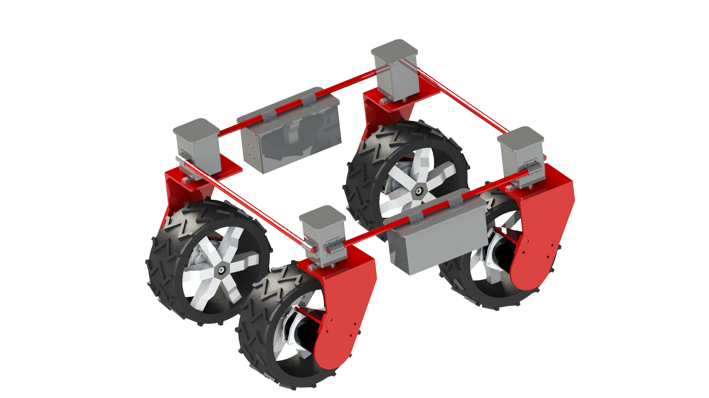



Hilly terrain workability
Rugged wheels
4-wheel drive
Independent steering
05

Slide 6
Adjustable Rods
Traction Battery
Steering Motor
Throttle Motor
Traction wheel
06

Slide 7
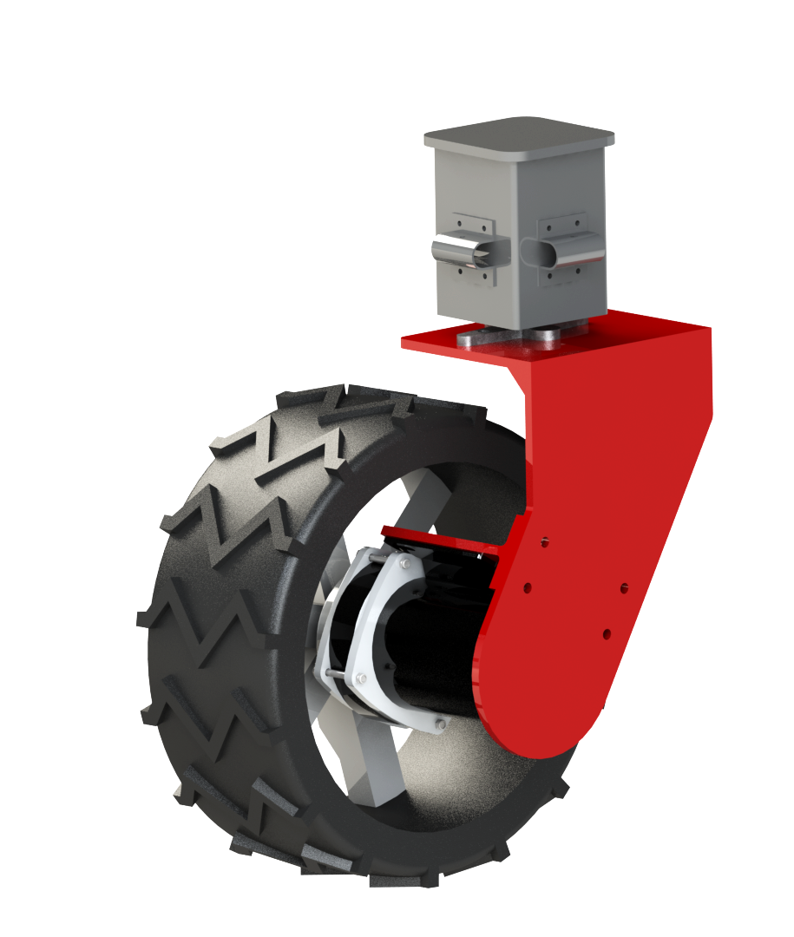
Slippage Prevention
Control system
Slip incorporated in kinematics model
High-power stepper motors
Mechanical system
Differential turning mechanism 4-wheel drive design
Staggered alignment of wheels for braking
07
Notes:
Modified tires

Slide 8

02
Seed metering mechanism

Slide 9
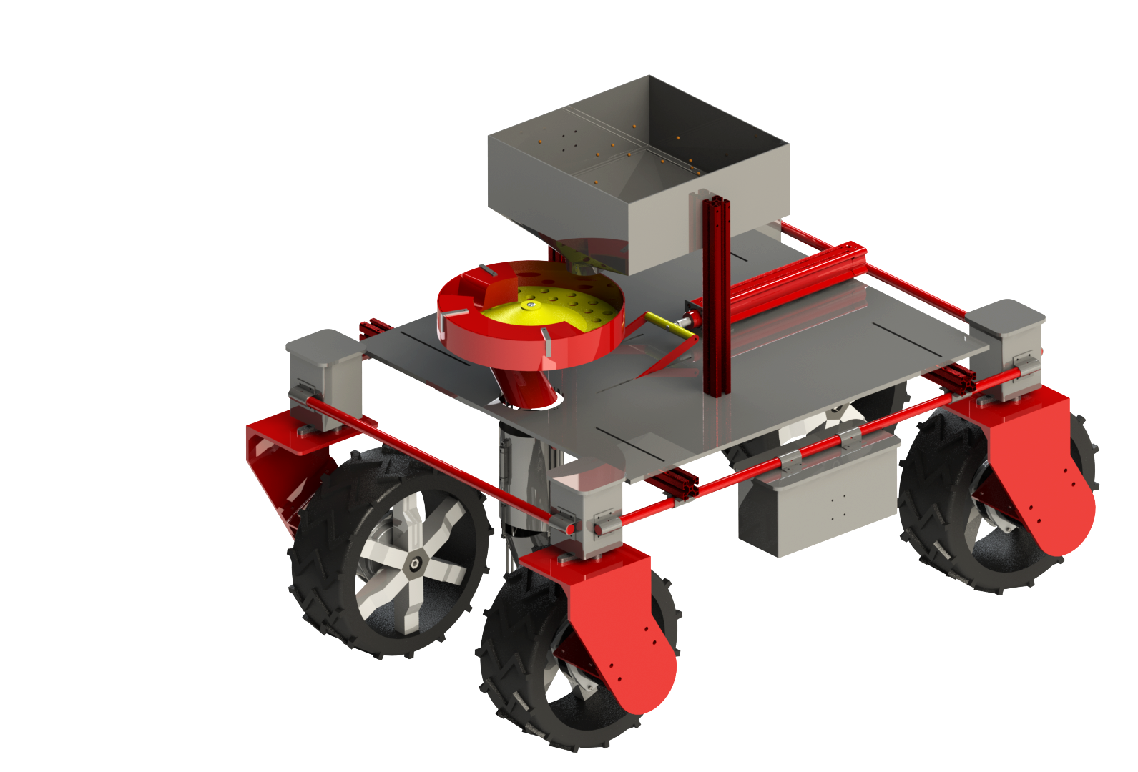



Seed metering mechanism
High cell filling rate
Metered drop of seeds
Suitable for several seed types
Features
Uneven and irregular crops / seeds metering
Controllable rate of seed sowing
Penetration of seed into the soil
09

Slide 10
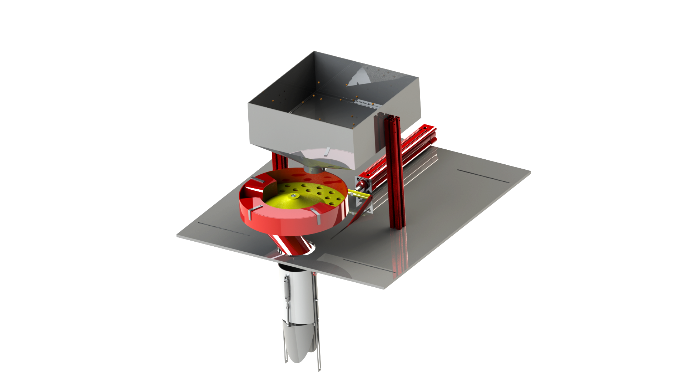
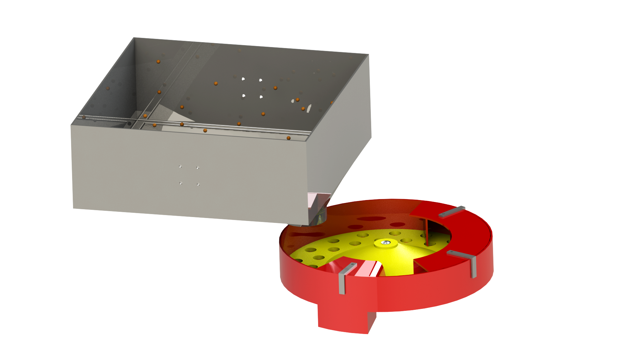
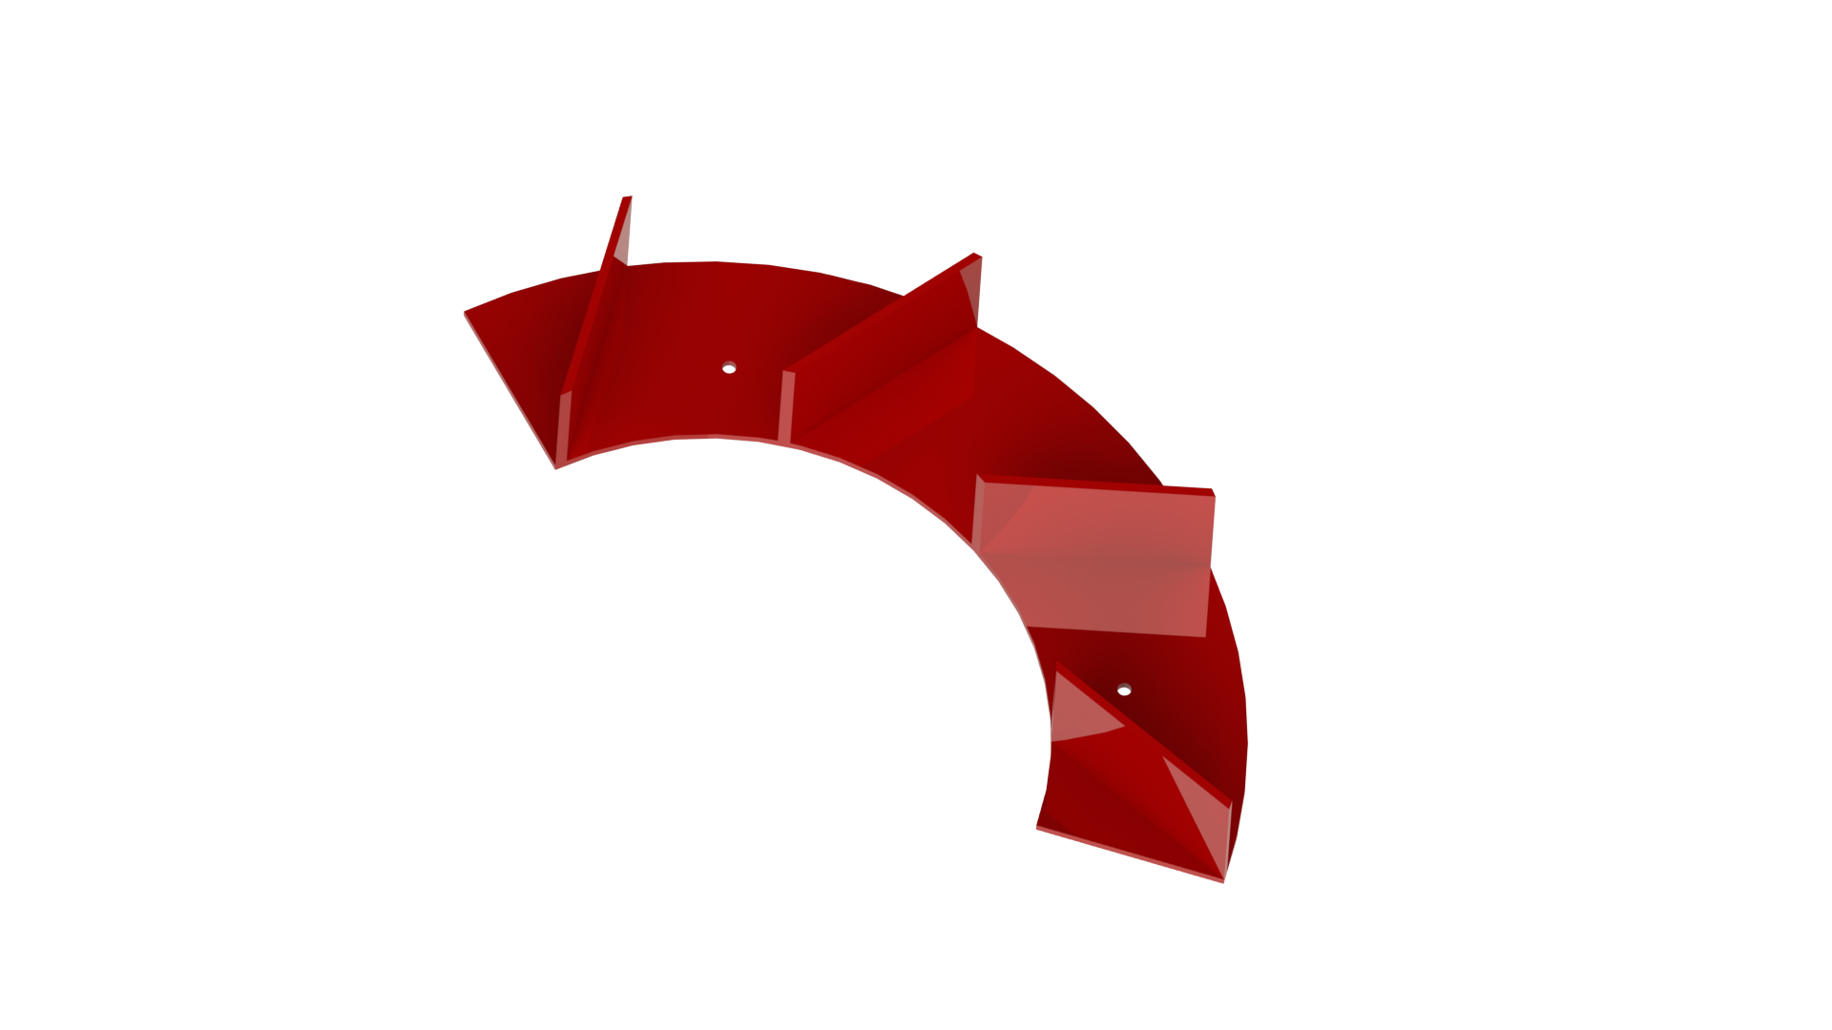
Components of the Seed Metering Mechanism
Hopper for seed storage
Horizontal rotor disk
Casing for rotating disk
Delivery pipe
Seed sowing mechanism
10

Slide 11
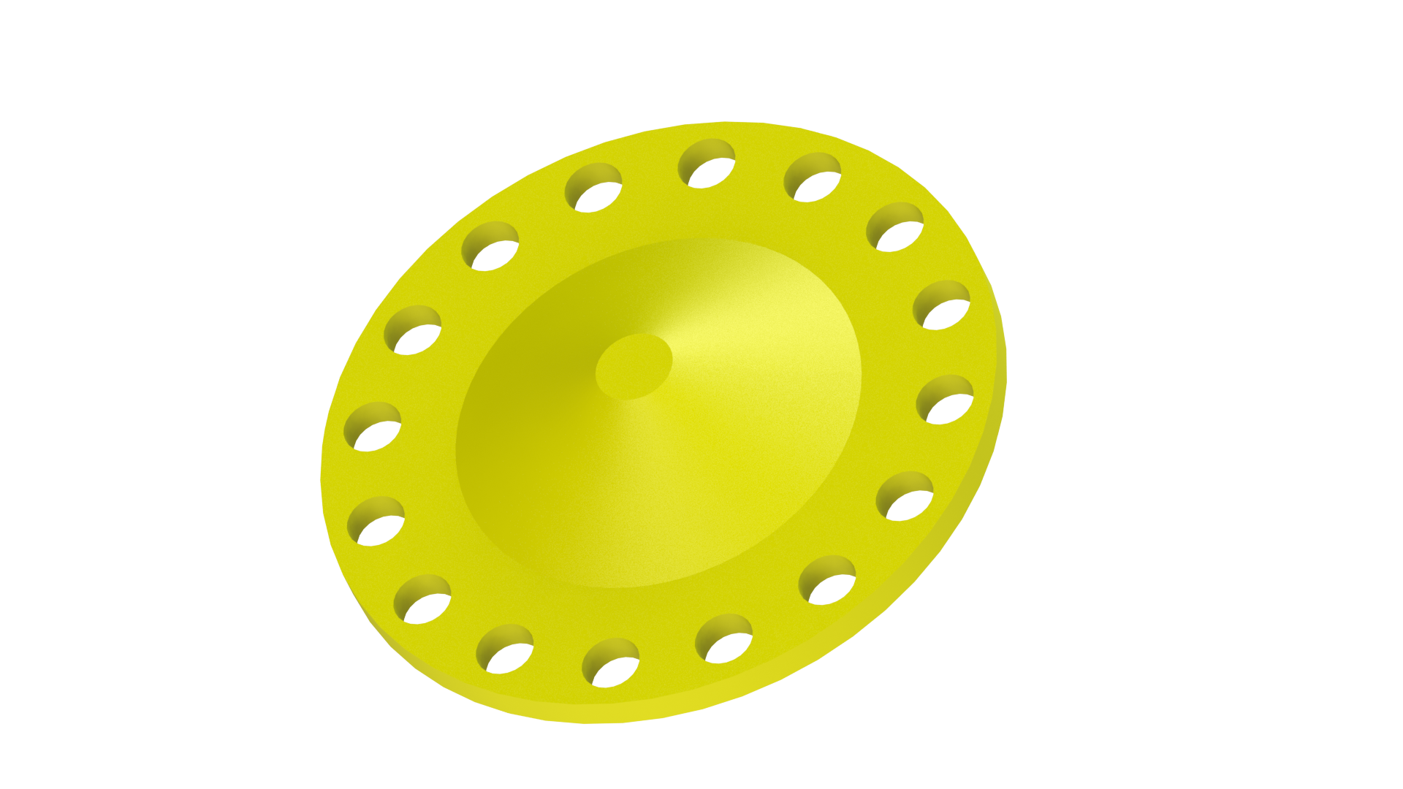
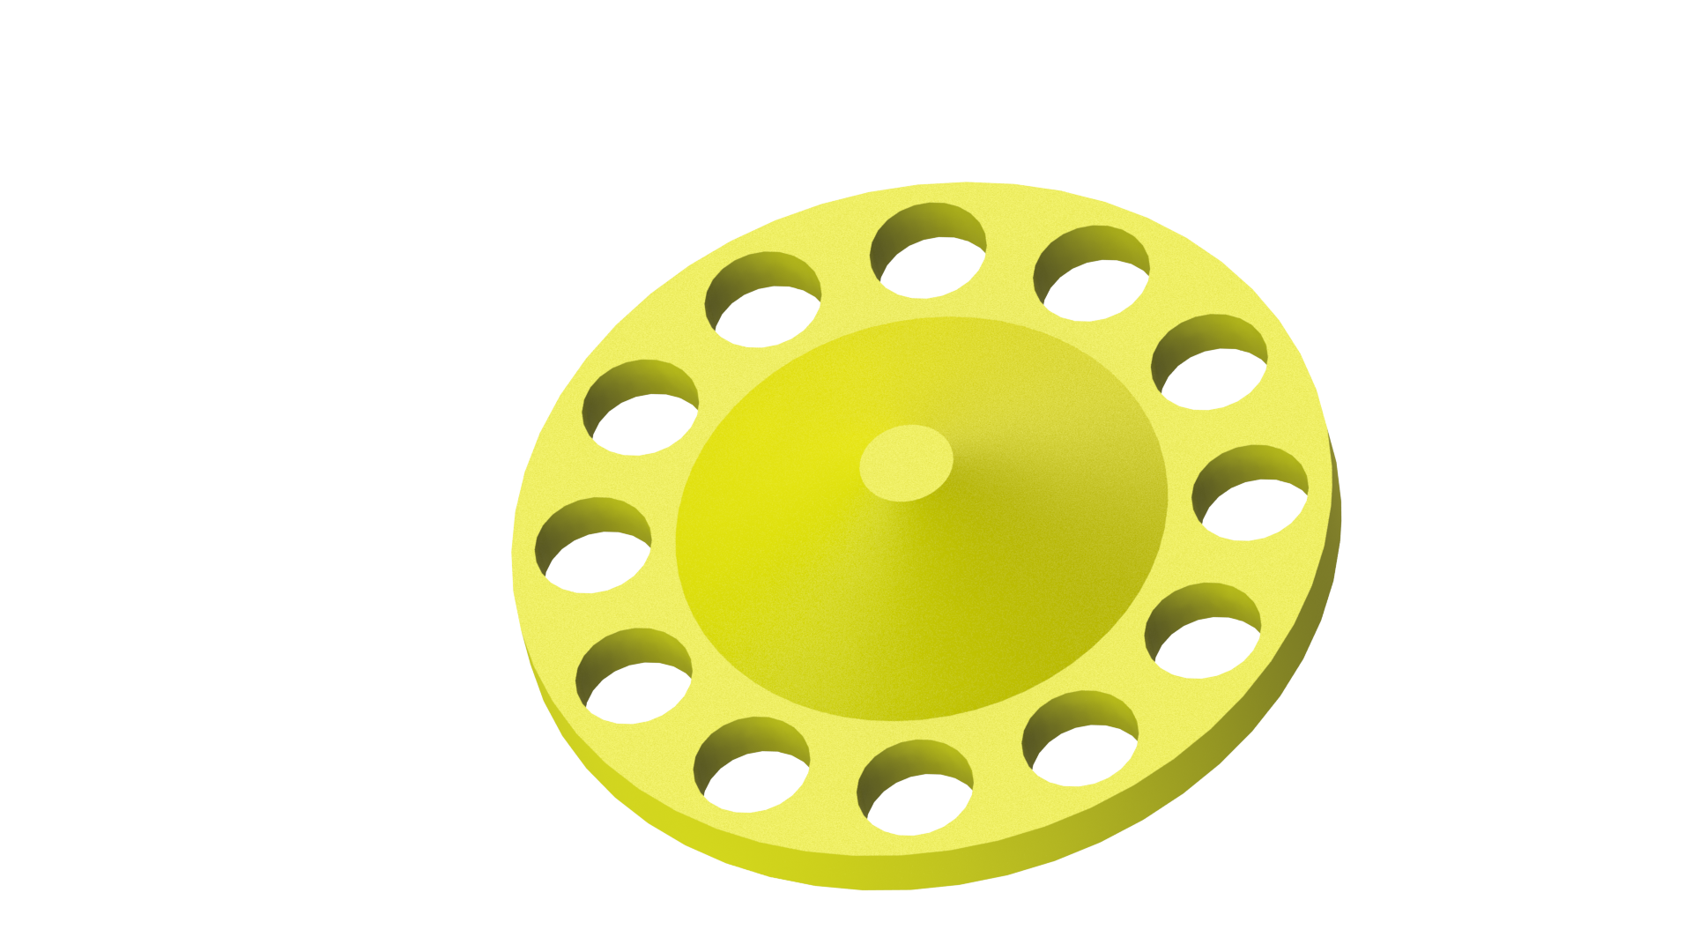
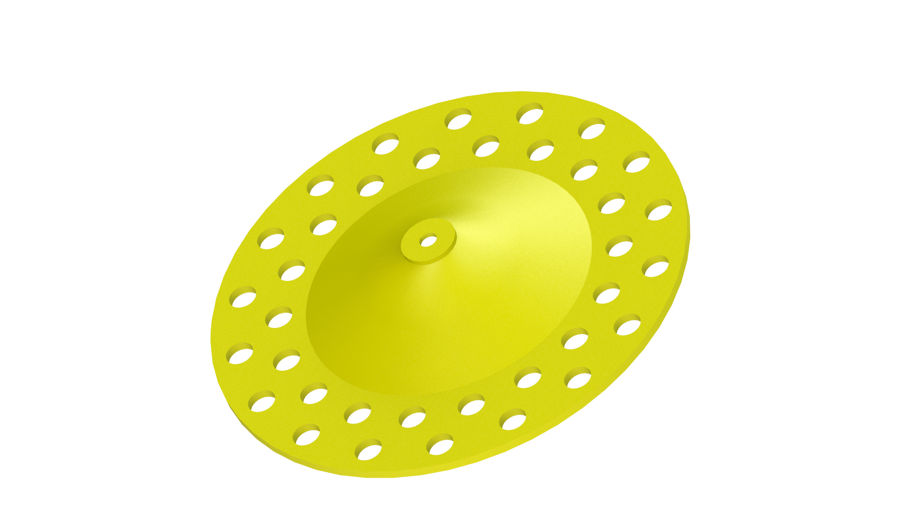

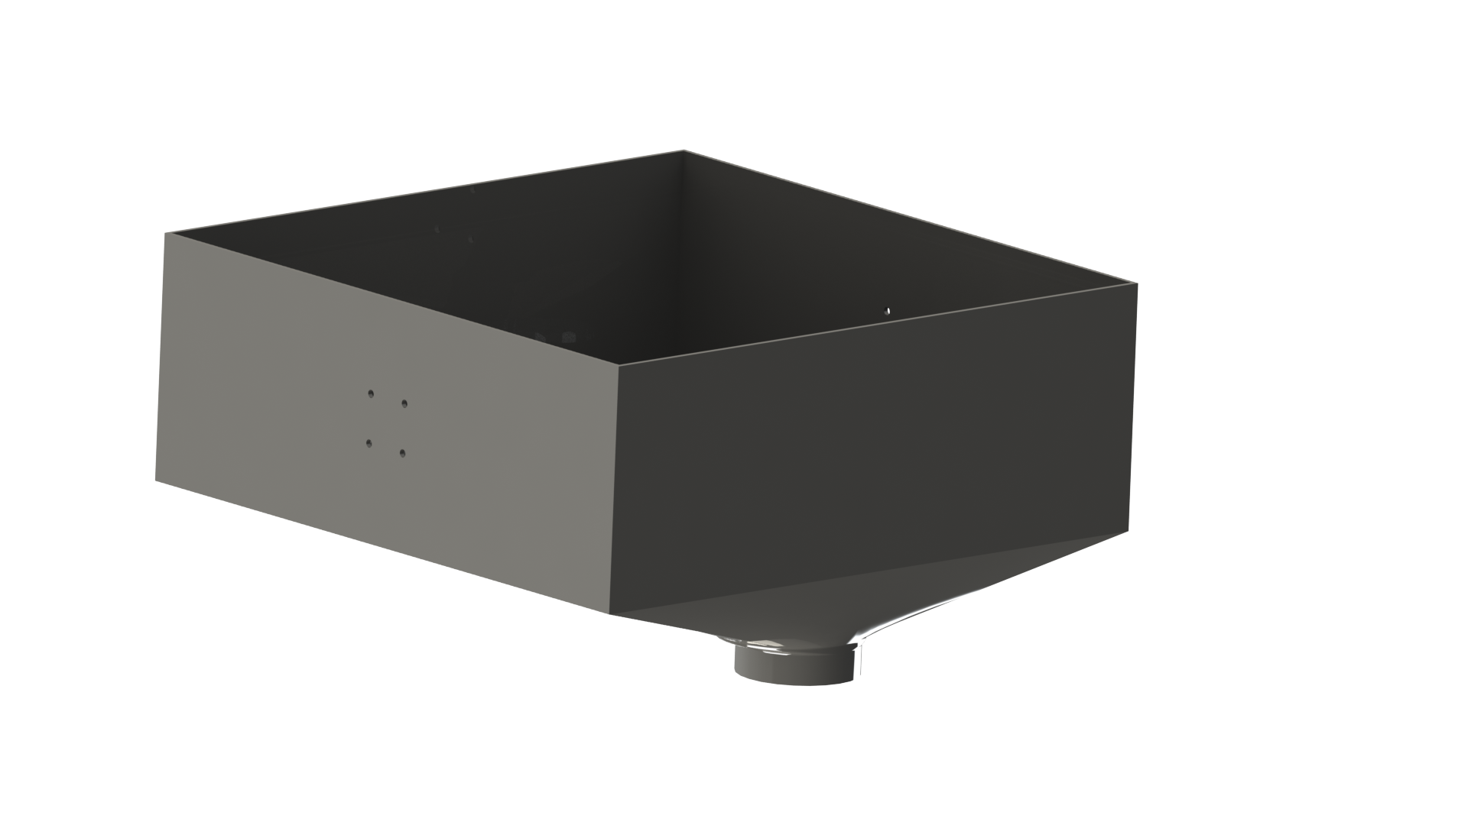

Components
Cell Size
Disks
Frequency
Cell size is derived from seed shape index calculated from seed dimensions & physical characteristics of seed.
The 3 interchangeable disk with cell size 10mm, 30mm, 50 mm each can accommodate most types and sizes of seeds.
Seedling spacing can be modified with disc motor RPM and robot forward speed
11

Slide 12
Mechanism
Step 1
Step 3
Seeds dumped in the hopper, screw adjustment mechanism controls seed rate
Seed rhizomes drop in the delivery tube as cell approaches bottom chute
Step 5
The rotor disk rotation speed ensures seed dropping at the correct spacing.
Step 2
Step 4
Cut-off plates to ensure specified seed amount fills each cell.
Calibration of the seed metering mechanism is calculated
12

Slide 13
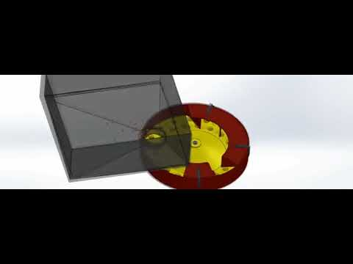
13

Slide 14
01
03
Impact
02
04
Controllable rate: fixed number of seeds dropped
Uniform penetration of seed into the soil
Reduction in damage to seeds
Usable for different types of seeds
14

Slide 15
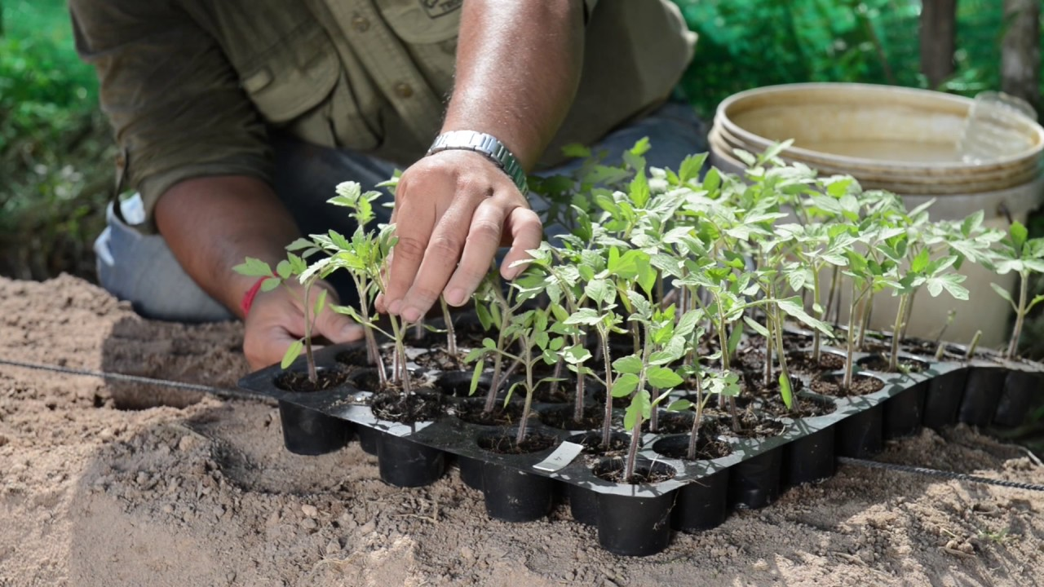
03
Transplantation

Slide 16
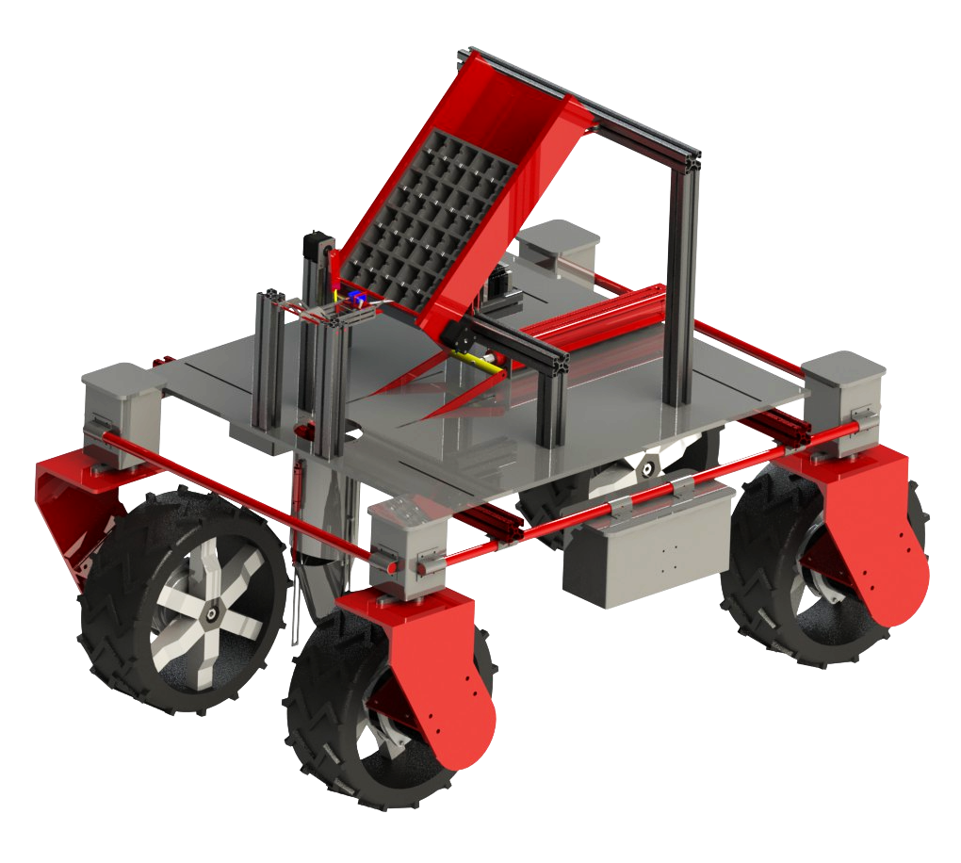



Transplantation
Uniform plantation
Refill of bot with seedling trays
Plantation of seedling to required depth
Comprises of:
Seedling gripper
Seedling Planter
16

Slide 17
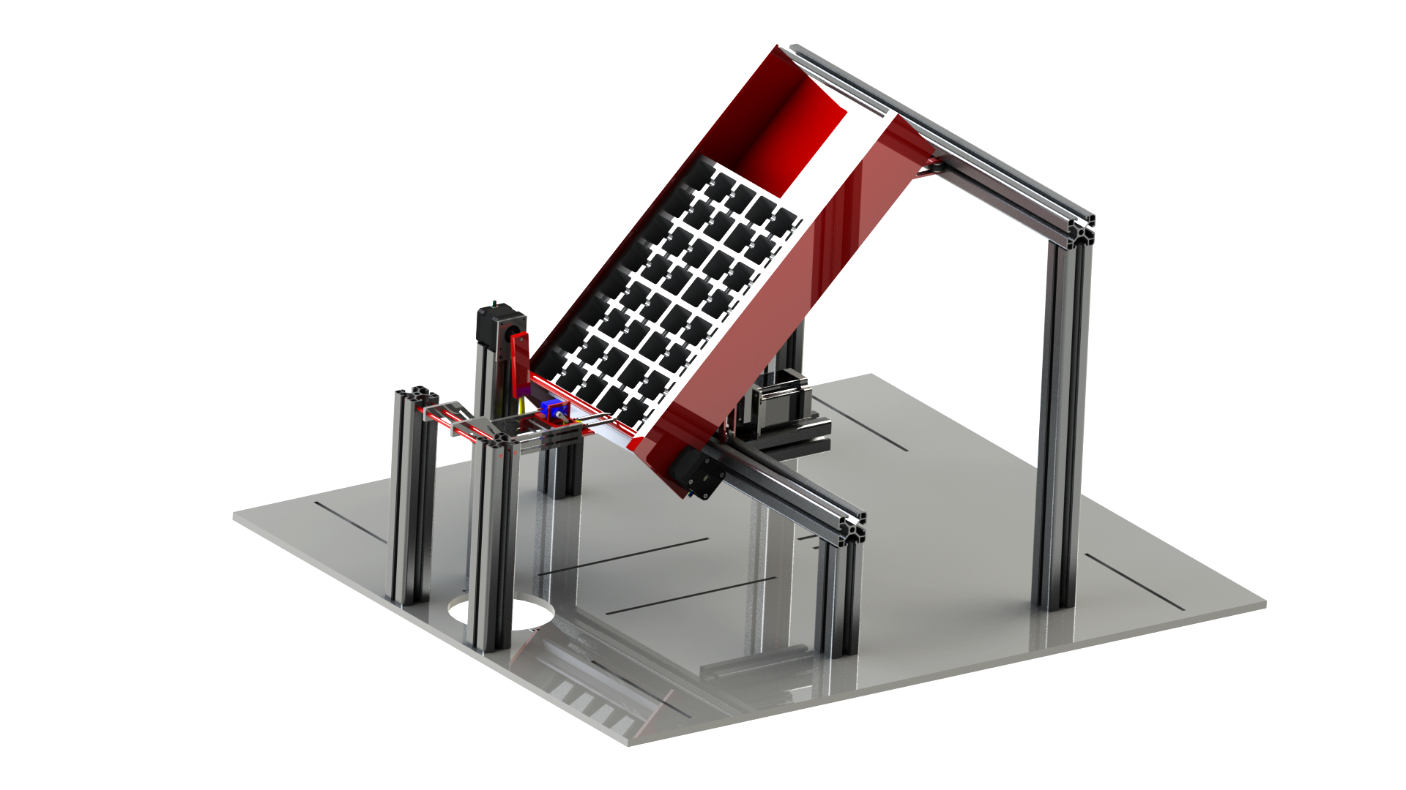
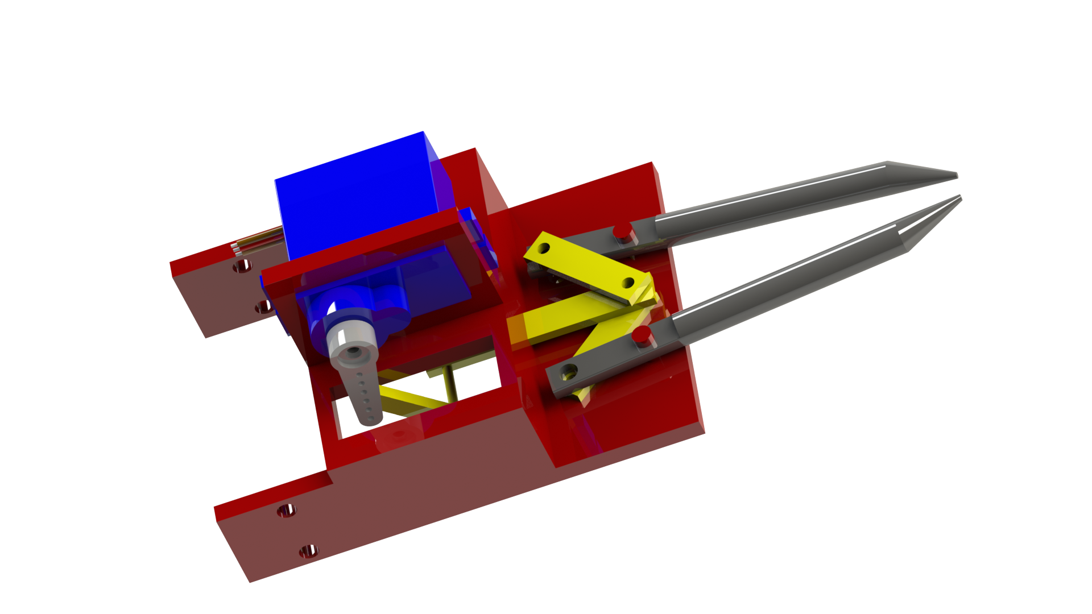
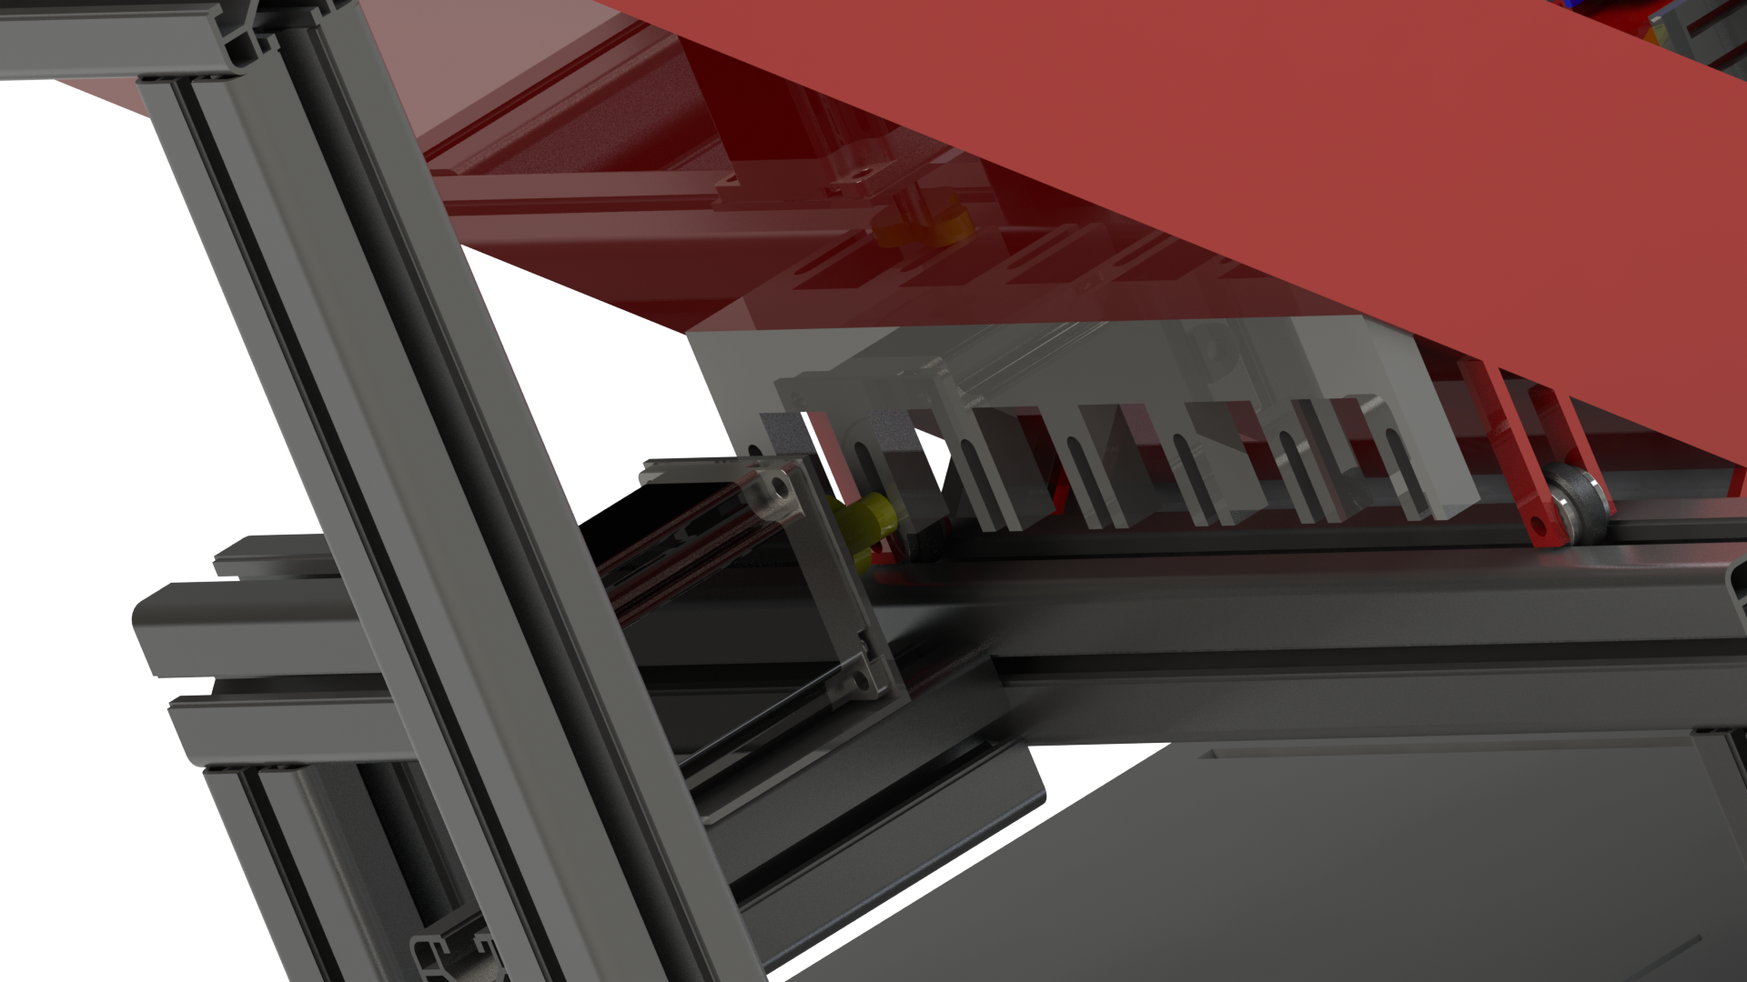
Seedling Gripper
Gripper grabs the seedling and puts it in the planter
Mechanism moves the tray linearly
17

Slide 18
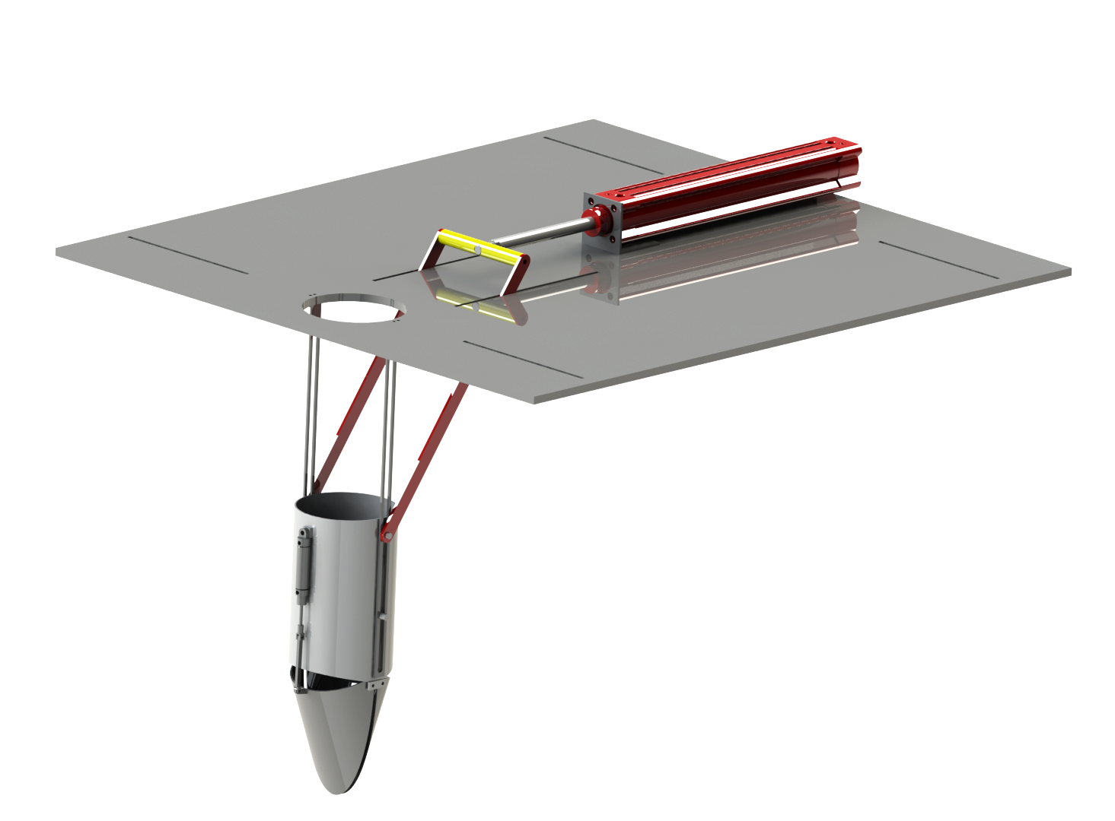
Seedling Planter
Once seedling is dropped from the gripper, the planter moves down into the soil with the help of a pneumatic actuator
It sows the seedling in the soil by opening its jaw
18

Slide 19
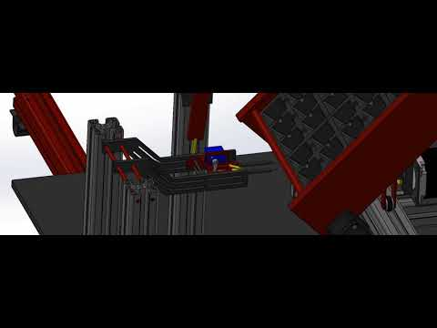
19

Slide 20
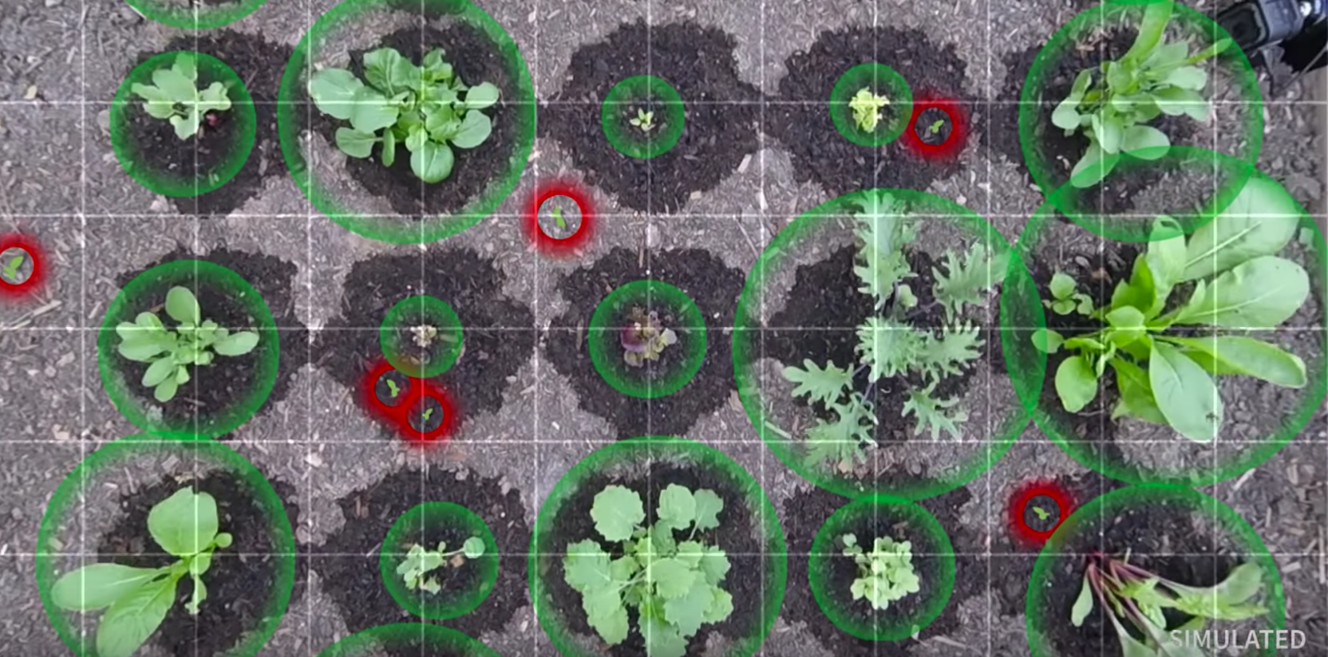
04
Weed Removal Mechanism

Slide 21
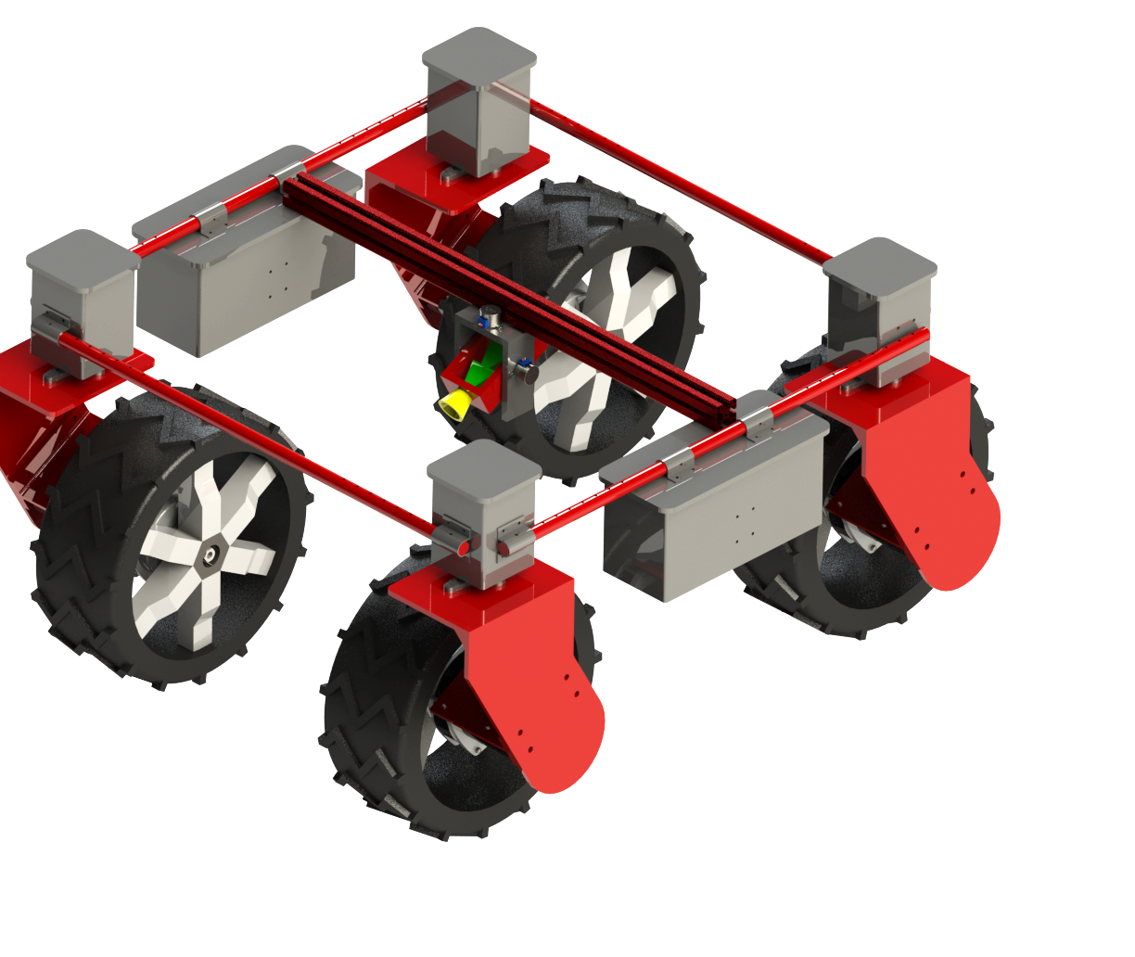
Weed removal mechanism
Features
Organic Weedicides
Mechanism
Liquid + Powder Spraying
Precision Spraying
2-axis Gimbal
Fertilizer Sprinkling
Atomizer: Liquid weedicide spraying
Customizable Nozzle for Widespread or Focused Spraying
Junction: Multiphase mixing (S + L)
Agitator: Clog destabilization
21

Slide 22
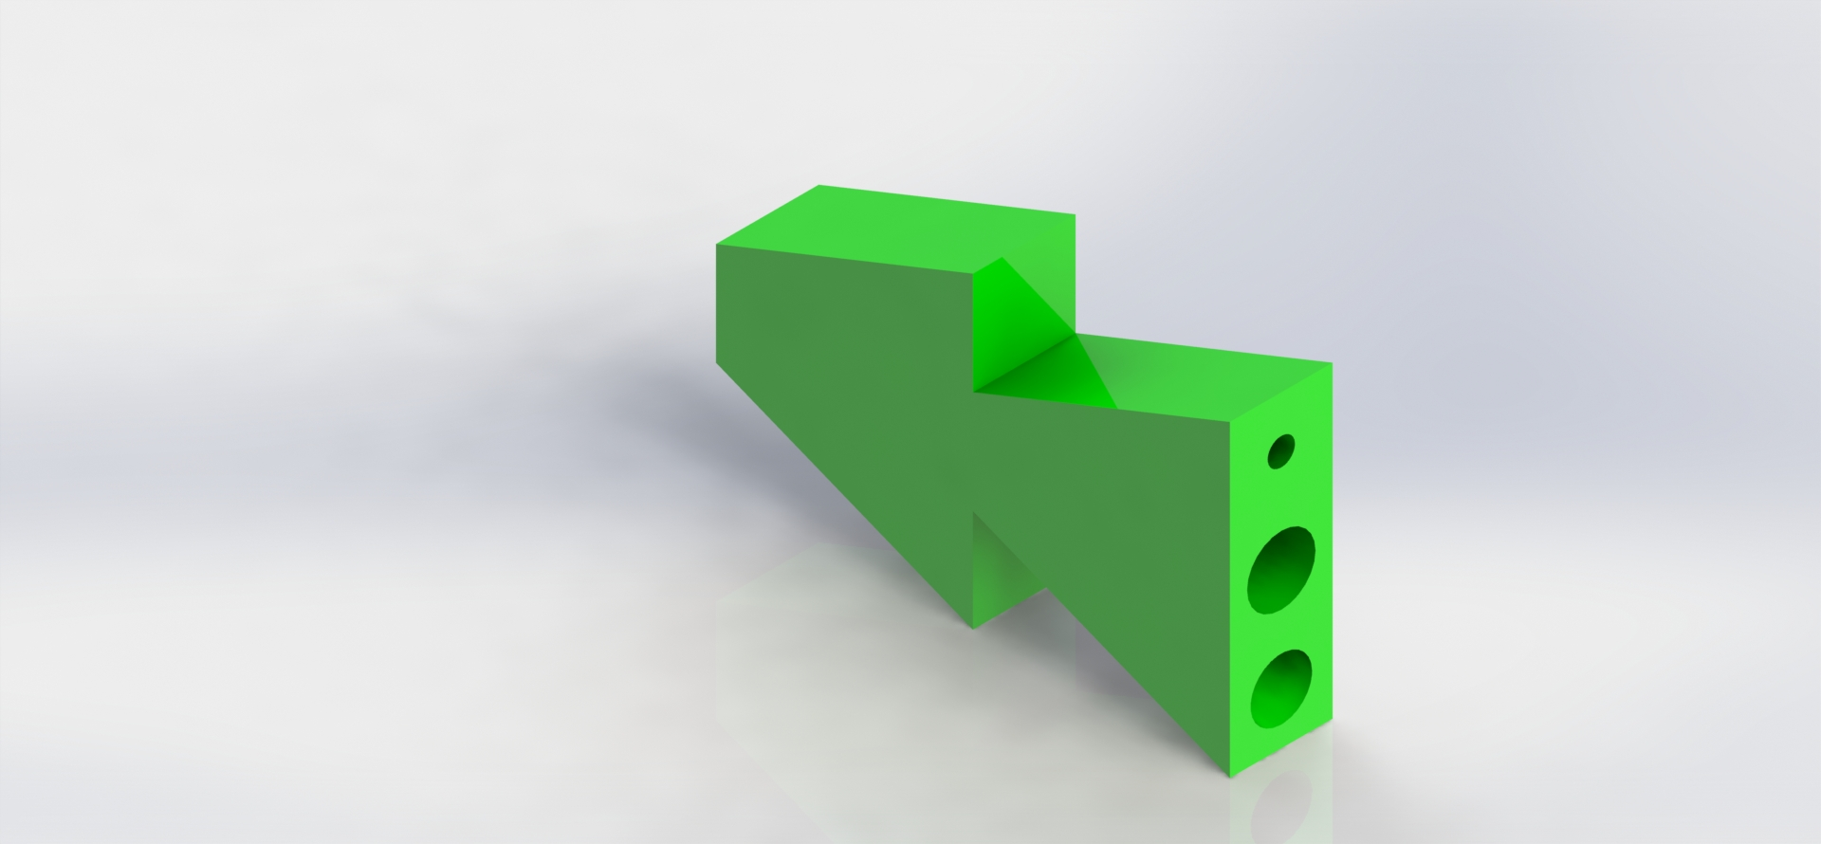
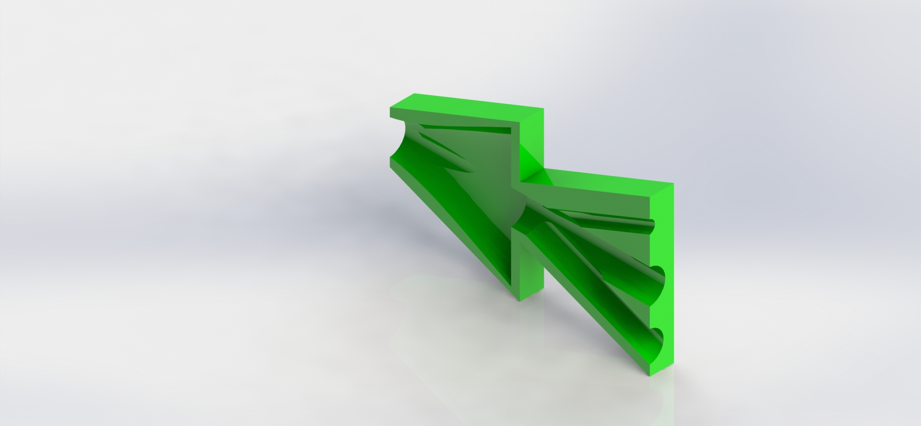
Junction : Cross-section
22

Slide 23
Why not?
Mechanical Weed Removal
Why?
Precision Spraying
Requirement of complete uprootal, segregation, and disposal of weeds
High maintenance cost
Possibility of damage to crop roots
95% more efficient (volume of weedicide) than traditional spraying
Lesser chemicals in the food chain even with inorganic weedicides
23

Slide 24
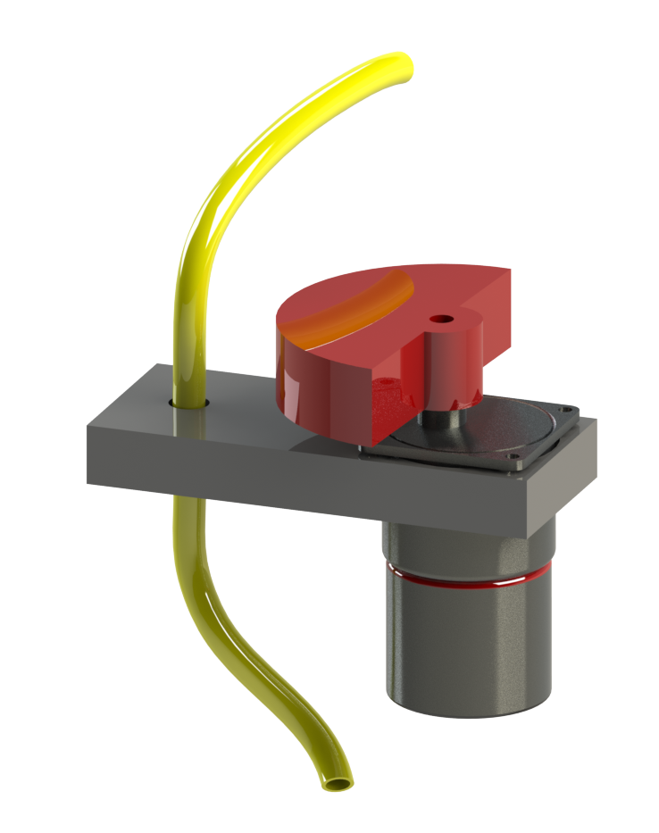
Agitator Mechanism
Shake it till you make it…
Placement: approximately halfway between junction and container
Destabilization of clogs inside the pipes
24

Slide 25

05
Extras

Slide 26
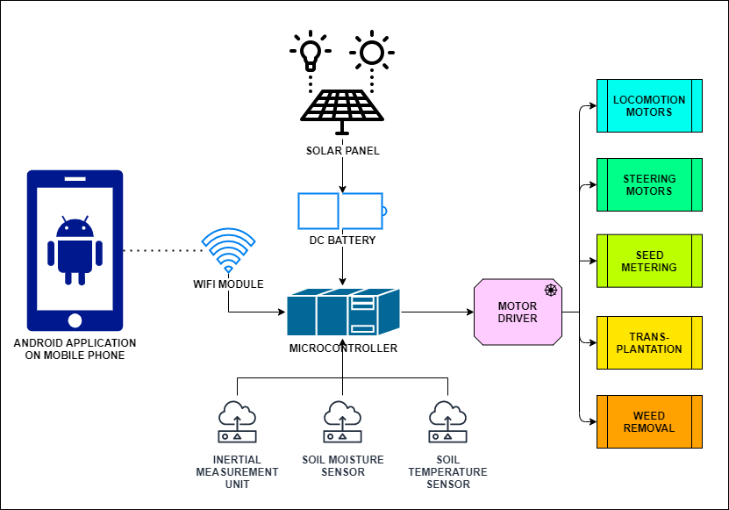
System Architecture
26

Slide 27
Extra Features
Renewable power source
Disease assessment on crops and light traps
Gyroscope ground level alert to prevent water stagnation
Manual steering control
Smartphone integration
27

Slide 28
01
02
Agrobot economics
03
04
Cost Mechanical hardware + Electronic hardware
Cost Issues: Co-operative ownership model and custom hiring approach
Innovation: Batteries + Sensors innovations will reduce cost
Energy Issues: Powered by renewable source of energy
28

Slide 29
Scalability and Realisation
Socio-Cultural
Rural Social Condition
Farmer Safety
Youth Skills
Role of AgroBot in Rural Sustainability
Farmer Income
Sustainable food products
Food Supply
Soil, water conservation
Biodiversity conservation
Economic
Ecological
29

Slide 30
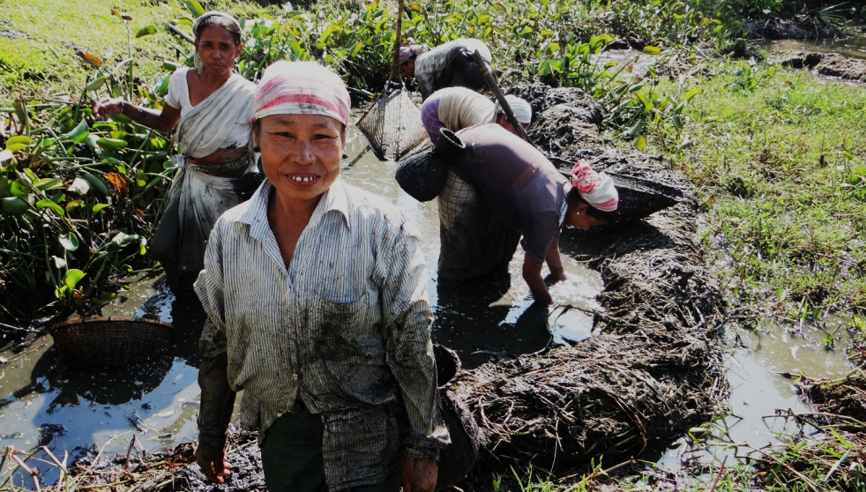
Thank You
Team M4_RTA_9

Slide 31


